Slide 1
5 Stages: The Journey of Disability Attitudes
Christine Guth, ADNet Program Director, christine@adnetonline.org
Special thanks to Dan Vander Plaats, Director of Advancement, Elim Christian Services

Slide 2
What is 5 Stages: The Journey of Disability Attitudes?
A one-page tool for sparking congregational conversations about disability attitudes

Slide 3
What is 5 Stages: The Journey of Disability Attitudes?
A spectrum that shows us how our we can grow and change in our attitudes toward people with disabilities
Originated by Dan Vander Plaats of Elim Christian Services
Notes:
Elim Christian Services (www.elimcs.org) has a section of its website on the 5 Stages, with videos, downloads, and explanations. Dan developed the copyrighted 5 Stages tool in collaboration with other Christian groups, including Disability Concerns of the Christian Reformed Church and Reformed Church in America. This PowerPoint was developed by ADNet with the permission of Elim Christian Services and Dan Vander Plaats.

Slide 4
Observations
What we think about disability has a lot to say about what we think about God.
Our attitudes toward people with disabilities may change over time.

Slide 5
Observations
We can recognize these stages in the biblical stories of God’s people
If we find ourselves in one of the first four stages, another stage in the journey invites us forward.

Slide 6
Observations
When we want to move to the next stage, spending time with someone who has a disa­bility is vital.

Slide 7
Observations
Each progressive stage teaches more about the true source of our value.
We don’t get our value from our accomplishments or from our disability, but from God.

Slide 8
Stage 1: Ignorance
People have disabilities because they lack faith or they are being punished for sin.
I don’t know anyone with a disability.
I am uncomfortable around people with disabilities and try to avoid them.
They are not my responsibility.
I see no reason to change.
Notes:
These are some of the beliefs that we may hold that suggest we are in the first stage of the journey, which we are calling Ignorance.
Tell a story about living in this stage, preferably from your own experiences.
You may also tell this story from Christine Guth’s experience if you like:
“When I was pregnant with both of my children, I was in my 30s. My biological clock was ticking. I knew that the rate of Down Syndrome increased with maternal age, and I lived in great fear that I’d have a child with Down Syndrome. Such a prospect felt like the worst of all possibilities, and I was greatly relieved after my children were born with no visible disability. A student who used a wheelchair and had a slight speech impediment was in the seminary class that I served as a student assistant. The student took his exams orally rather than writing them out longhand. I am ashamed to say it, but I avoided him. I remember the relief I felt when the professor said he would listen to and grade the oral exams instead of me.”

Slide 9
Stage 1: Ignorance
Two blind men were sitting by the roadside. When they heard that Jesus was passing by, they shouted, "Lord, have mercy on us, Son of David!" The crowd sternly ordered them to be quiet. Matt. 20:30-31
The LORD will afflict you with madness, blindness, and confusion of mind. Deut 28:28
http://www.flickr.com/photos/kandinsky2/416133079
Notes:
We can find each of the five stages of the journey within the biblical stories of God’s people. We show this by pairing a representative Bible verse or two with each stage of the journey. These biblical texts remind us that no stage is bad, but if we find ourselves in one of the first four stages, another stage in the journey beckons to us, inviting us to take a step toward stronger relation­ships with people with disabilities and deeper aware­ness of their indispensable place in the body of Christ.

Slide 10
Stage 2: Pity
People with disabilities are needy and I feel sorry for them.
Someone should help them and give their lives meaning.
But, thank God, no one in my family has a disability.
Notes:
These are some of the beliefs that we may hold that suggest we are in the second stage of the journey, Pity.
Tell a story about living in this stage, preferably from your own experiences.
You may also tell this story from Christine Guth’s experience if you like:
“When a friend of mine gave birth to a child with Down Syndrome, I expressed my sympathy to her. She did not accept my sympathies, and I was puzzled.”

Slide 11
Stage 2: Pity
For he delivers the needy when they call, the poor and those who have no helper. He has pity on the weak and the needy, and saves the lives of the needy. Psalm 72:12-13
http://en.wikipedia.org/wiki/File:Helping_the_homeless.jpg

Slide 12
Stage 3: Care
Like me, people with disabilities were created in God’s image; for this reason their lives have value.
I hope that someone will take the time to show them God’s love.
I will happily support such an effort.
Notes:
These are some of the beliefs that we may hold that suggest we are in the third stage of the journey, Care.
Often we see the stage of care as the end of the line, the ultimate aim of biblical compassion, not recognizing that other stages are possible.
Tell a story about living in this stage, preferably from your own experiences.
You may also tell this story from Christine Guth’s experience if you like:
“Some ten years after I became a parent, the older of my two children received the diagnosis of an autism spectrum disorder. Five years later, my second child was given the same diagnosis. The developmental disability that I had so feared when my children were still in the womb had become a reality. At this stage, however, disability was no longer a cause for fear. I had come to know and love my children, and wanted the best of care for them. I saw their potential, and it never occurred to me to feel sorry for them. As I was learning from them about living with autism, I began to sense God’s calling me to extend God’s care to other people living with disabilities.”

Slide 13
Stage 3: Care
“Truly I tell you, just as you did it to one of the least of these who are members of my family, you did it to me.”' Matt. 25:40
Notes:
The parable of the sheep and the goats in Matthew 25 has long been an inspiration within Anabaptist traditions for lives given in service. This is as it should be; however, Christine Guth offers a word of caution about the phrase, “the least of these.” In Supportive Care in the Congregation, she writes: “If the flow of service is one way only, from giver to receiver, and I am always the giver, and I always see you and never myself as ‘the least of these,’ I risk treating you with condescension. We must also allow the roles to freely reverse, for at times, God knows, I am also ‘the least of these.’”

Slide 14
Stage 4: Friendship
I have come to know and spend time with a friend who has a disability.
My friend has value in God’s sight, but also in mine.
My life is better for knowing my friend, and she has blessed me as much as I have helped her.
I am learning to accept and love my own limitations.
Notes:
But there are possibilities in the journey as we move beyond simply offering care. These are some of the beliefs that we may hold that suggest we are in the fourth stage of the journey, friendship.
Tell a story about living in this stage, preferably from your own experiences.
You may also tell this story from Christine Guth’s experience if you like:
“A class I took a few years ago helped me to move beyond stage 3. During the 8 months of this disability advocacy class, I began to make friends with classmates living with intellectual disabilities. As friends, we learned how much we had in common. My friends with disabilities helped move me to greater acceptance of my own mental illness. I realized it was no longer something to be ashamed of. I stopped wishing it had never happened to me, and began to see it as a part of me that I could use to construct a meaningful life.”

Slide 15
Stage 4: Friendship
God chose what is foolish in the world to shame the wise; God chose what is weak in the world to shame the strong. 1 Cor. 1:27
No one has greater love than this, to lay down one's life for one's friends. I do not call you servants any longer…but I have called you friends. John 15:13, 15

Slide 16
Stage 5: Co-Laborers
People with disabilities are co-laborers in God’s kingdom, sharing ministry gifts needed by the body of Christ.
Together, we who live with disabilities and we who have no apparent disability are encouraging and equipping each other in every good work.
Notes:
As we grow in friendship with persons with disabilities, we begin to recognize the gifts they have to share with the body of Christ.
These are some of the beliefs that we may hold that suggest we are in the fifth stage of the journey, Co-laborers.
How do you envision your congregation living into this stage in the journey? Share a glimpse of that vision.

Slide 17
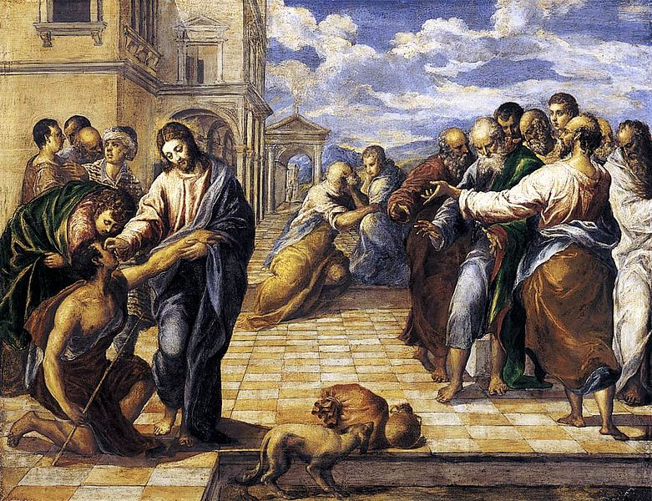
Stage 5: Co-Laborers
Jesus answered, "Neither this man nor his parents sinned; he was born blind so that God's works might be revealed in him.” John 9:3
http://en.wikipedia.org/wiki/File:La_curacion_del_ciego_El_Greco_Dresde.jpg
Notes:
Ironically, In John 9, it is the man who was born blind who becomes the most able to see and profess who Jesus really is.

Slide 18
Where am I on the journey?
Notes:
You can invite people to reflect on these questions in silence, or to engage in conversation about them with the person sitting beside them.
Where am I on the journey? Is it changing? What step is God inviting me toward?

Slide 19
Final reminders
Each stage holds an invitation to move to the next
Change comes from engaging someone with disabilities
Our value lies in God's love for us and our place in God’s redemptive plan
Notes:
Final points to remember
If we are in Stages 1-4, there’s no reason to feel bad about stage we are in, but remember each stage holds an invitation to move to the next.
Remember: No matter when or how you move to the next stage, realize that change has to do with one simple thing: engaging someone with disabilities. Building relationships.
And remember, What makes people with disabilities valuable is the same as for people without disabilities, as it is for you and me. It's not about who we are and what we can accomplish. Our value lies in God's love for us and our place in God’s redemptive plan.

Slide 20
Credit where credit is due!
Adapted with permission from 5 Stages: The Journey of Disability Attitudes © 2013, Elim Christian Services and Dan Vander Plaats.
Visit the 5 Stages website to learn more: www.the5stages.com

