Slide 1
A RESOURCE OF ELIM CHRISTIAN SERVICES
“5 STAGES: CHANGING ATTITUDES”
© 2014 ELIM CHRISTIAN SERVICES, DAN VANDER PLAATS

Slide 2
Only 47% of people with disabilities attend a religious service at least once a month

Slide 3
85% of Christian families affected by disability do not attend church because they do not feel welcome.

Slide 4
19% of families include someone living with a disabling condition
(2-3% with developmental disabilities)

Slide 5
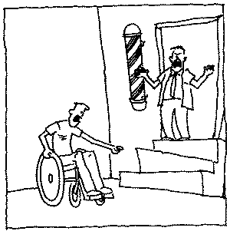

Slide 7
It’s about the attitudes

Slide 8
“Two blind men were sitting by the roadside, and when they heard that Jesus was going by, they shouted, ‘Lord, Son of David, have mercy on us!’ The crowd rebuked them and told them to be quiet...”
- Matthew 20:30-31

Slide 9
“He will take pity on the weak and the needy and save the needy from death.”
- Psalm 72:13

Slide 10
“The King will reply, ‘Truly I tell you, whatever you did for one of the least of these brothers and sisters of mine, you did for me.’”
- Matthew 25:40

Slide 11
“‘Go out quickly into the streets and alleys of the town and bring in the poor, the crippled, the blind and the lame…Go out to the roads and country lanes and compel them to come in, so that my house will be full.’”
- Luke 14: 21 & 23

Slide 12
Theological Foundations
Value comes not from accomplishment,
or from our disability, but from God
Disability is not a blessing,
but it is also not a curse
We are all disabled,
but we are also not all disabled
God made me, but not this way

Slide 13
A RESOURCE OF ELIM CHRISTIAN SERVICES
“5 STAGES: CHANGING ATTITUDES”
© 2014 ELIM CHRISTIAN SERVICES, DAN VANDER PLAATS

Slide 14
STAGE 1: IGNORANCE

Slide 15
STAGE 1: IGNORANCE
STAGE 2: PITY

Slide 16
STAGE 1: IGNORANCE
STAGE 2: PITY
STAGE 3: CARE

Slide 17
use short video here
http://www.the5stages.com/resources/videos-2/

Slide 18
STAGE 1: IGNORANCE
STAGE 2: PITY
STAGE 3: CARE

Slide 19
“But God chose the foolish things of the world to shame the wise; God chose the weak things of the world to shame the strong. God chose the lowly things of this world and the despised things—and the things that are not—to nullify the things that are...”
- I Corinthians 1:27

Slide 20
STAGE 1: IGNORANCE
STAGE 2: PITY
STAGE 3: CARE
STAGE 4: FRIENDSHIP

Slide 21
“‘Neither this man nor his parents sinned,’ said Jesus, ‘but this happened so that the works of God might be displayed in him.’”
- John 9:3

Slide 22
STAGE 1: IGNORANCE
STAGE 2: PITY
STAGE 3: CARE
STAGE 4: FRIENDSHIP
STAGE 5: CO-LABORERS

Slide 23
*
There is No Asterisk

Slide 24
“All Scripture is God-breathed and is useful for teaching, rebuking, correcting and training in righteousness, so that the servant of God may be thoroughly equipped for every good work.”
- 2 Timothy 3:16-17

Slide 25
“Therefore encourage one another and build each other up, just as in fact you are doing.”
- 1 Thessalonians 5:11

Slide 26
“For we are God’s handiwork, created in Christ Jesus to do good works, which God prepared in advance for us to do.”
- Ephesians 2:10

Slide 27
What stage are you?
What are you going to do about it?

Slide 28
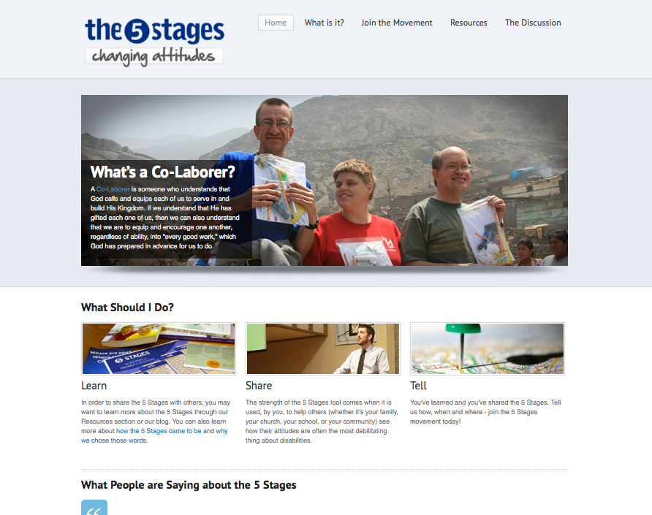
www.the5stages.com
VIDEOS, DIAGRAMS, HANDOUTS

Slide 29
A RESOURCE OF ELIM CHRISTIAN SERVICES
“5 STAGES: CHANGING ATTITUDES”
© 2014 ELIM CHRISTIAN SERVICES, DAN VANDER PLAATS

